Slide 1

A Puzzle from Pineapple Juice
YC, Imaging Solutions
Notes:
A Puzzle from pineapple juice
In this talk I will share the little analysis we did with previous performance testing data where we look at:
Whether the pineapple juice ingested by participants for MRCP have an impact on the cT1 values?
The findings help us reduce unintended potential variabilities in our quantifications and gave us confidence on changing the order of our image acquisition protocols.

Slide 2
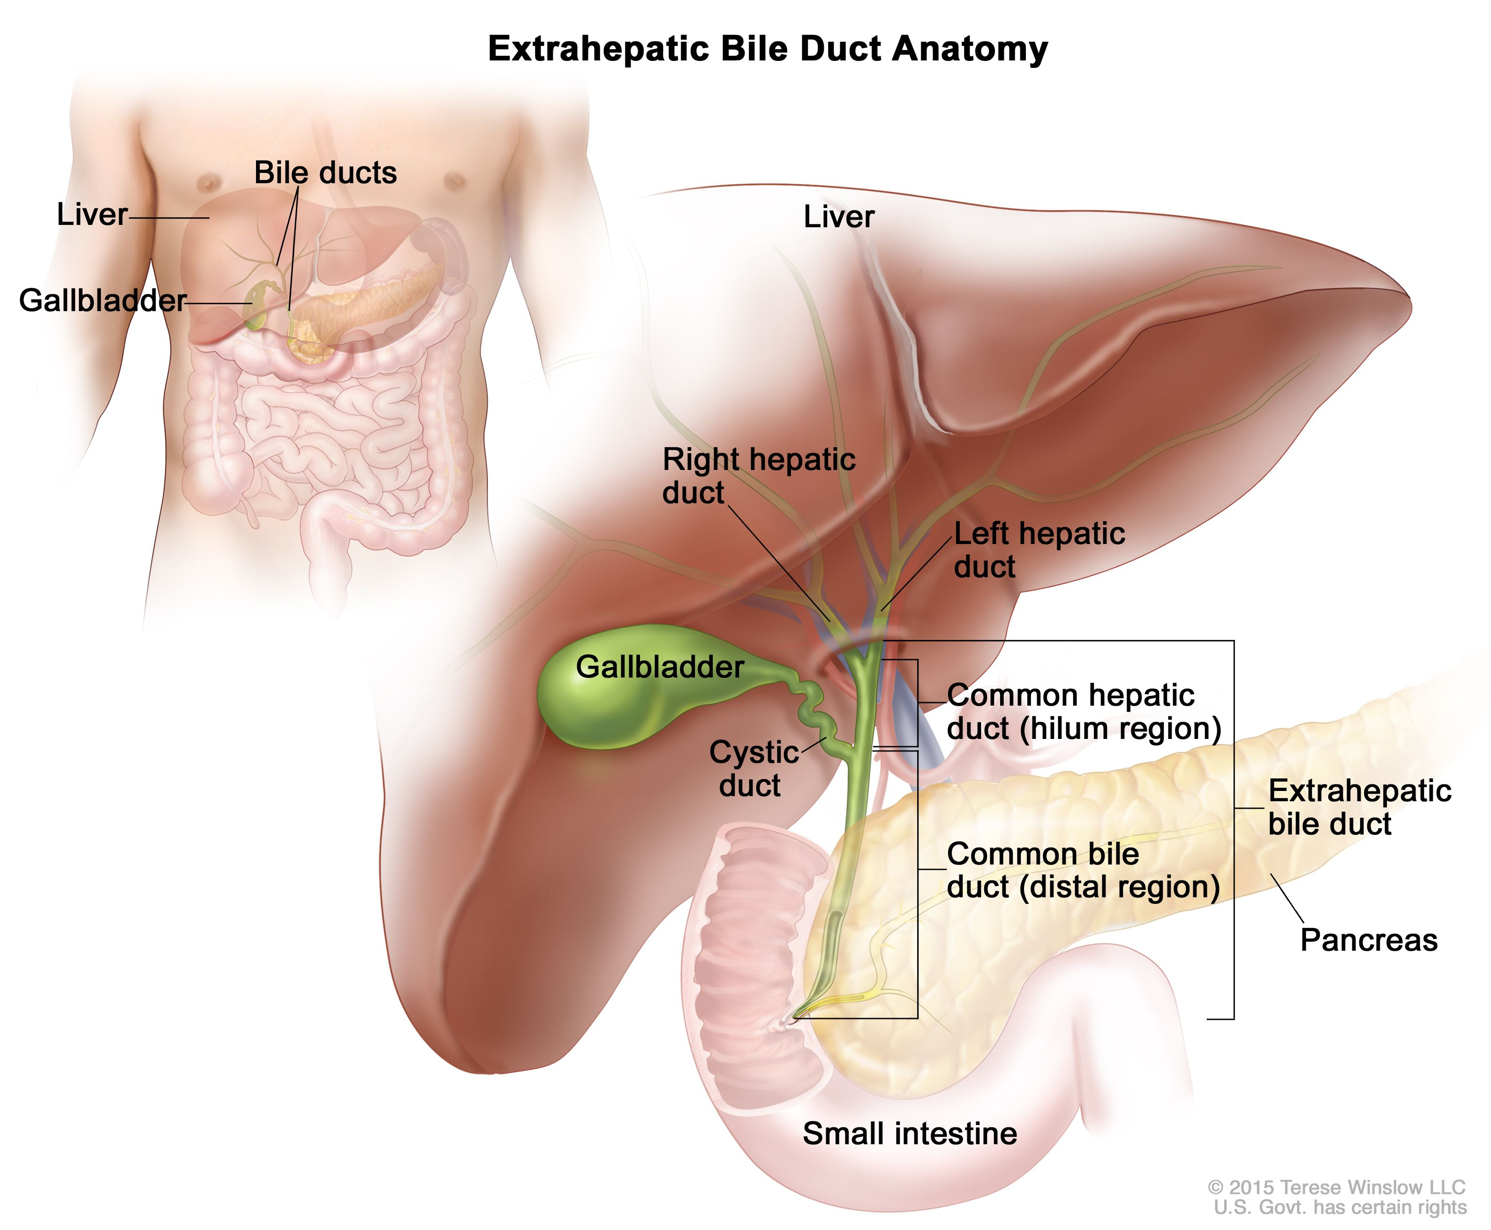
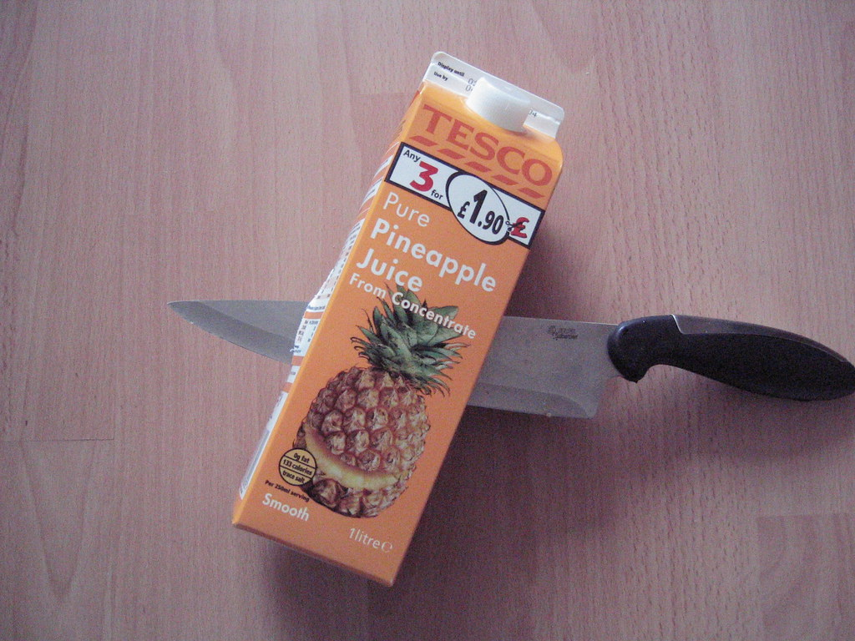
Why use pineapple juice?
Pineapple Juice
Manganese(Mn) concentration in pure PJ: 27.6 mg/L
shortened T2 relaxation time and hence decreased T2 signal intensity
suppress gastric fluid signal from gastrointestinal tract
shown to achieve comparable result as the commercial negative contrast agent: ferumoxsil (Superparamagnetic iron oxide (SPIO))
Riordan, R D et al. “Pineapple juice as a negative oral contrast agent in magnetic resonance cholangiopancreatography: a preliminary evaluation.”
The British journal of radiology vol. 77,924 (2004): 991-9. doi:10.1259/bjr/36674326
Leung, Kam. “Ferumoxsil.” Molecular Imaging and Contrast Agent Database (MICAD), National Center for Biotechnology Information (US), 1 November 2004.

Slide 3
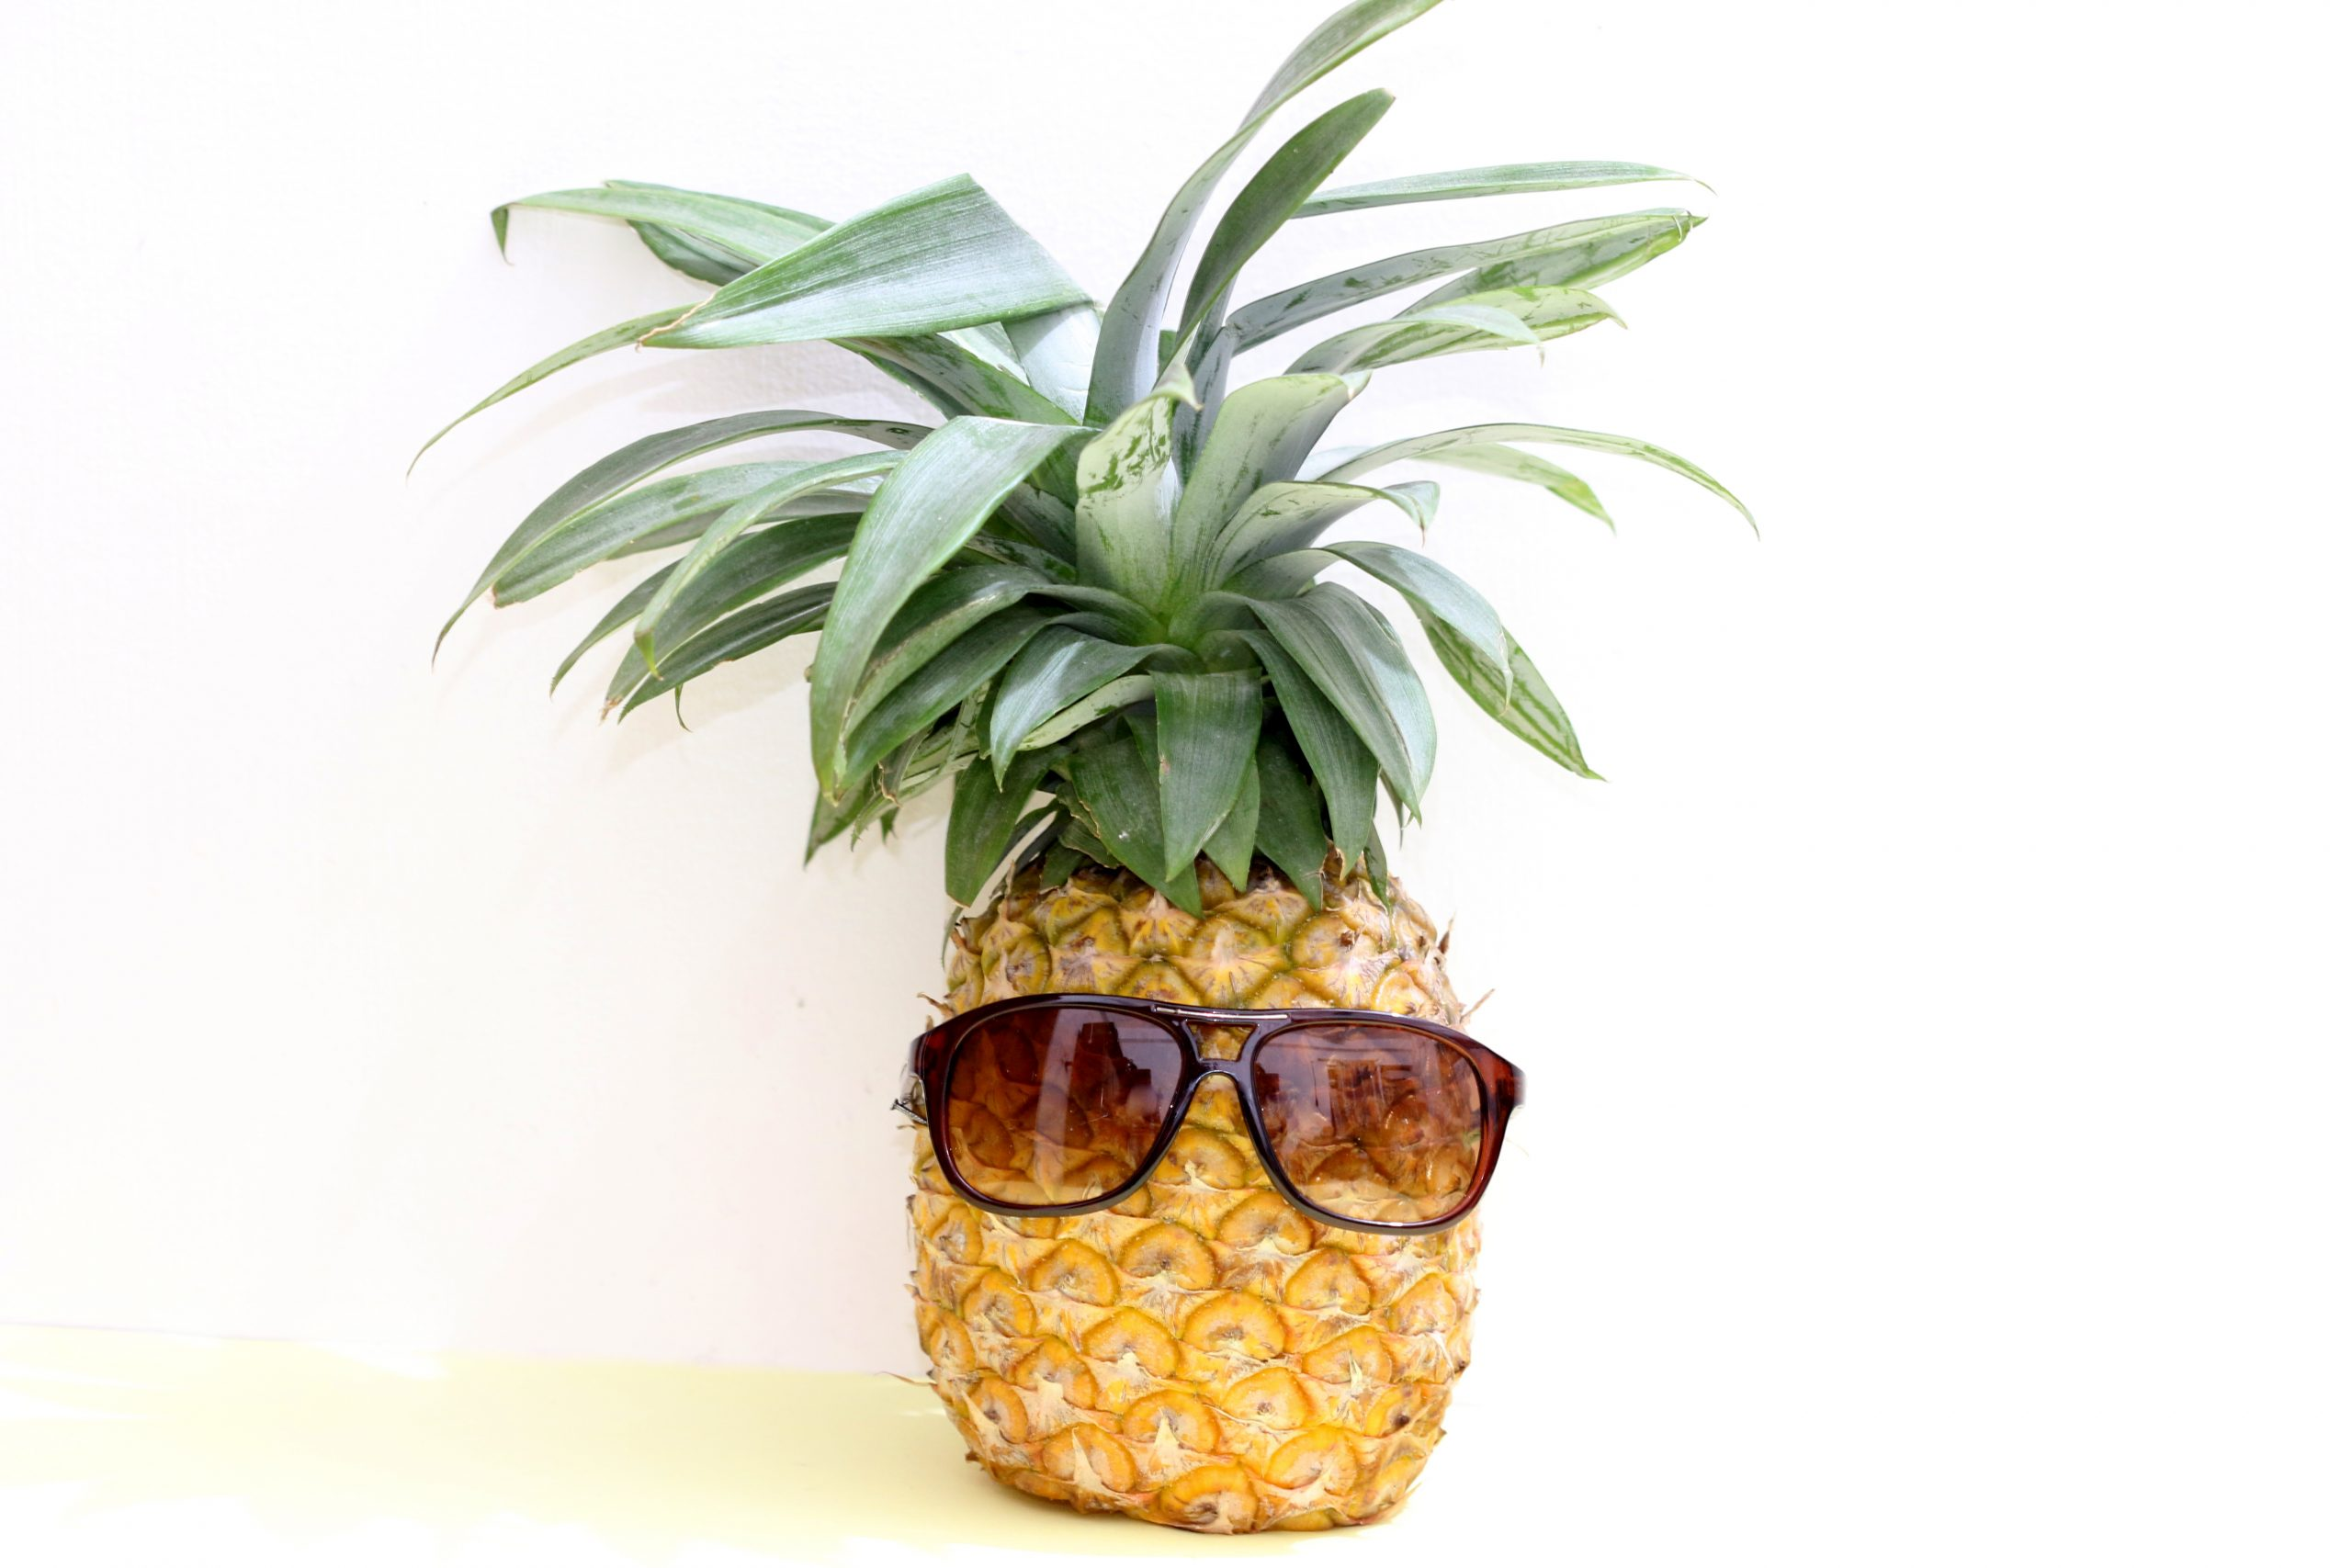

Motivation
💡our devices can interchangeably provide insights of measurements!💡
Does the pineapple juice affect your cT1?
Notes:
Children age 5-15
Different image emethod
Simple question: Does Pineapple juice effect the cT1 - We should know
We asked around, as far as we could go, digged out any report or document on MRCP but there wasn't anything
We found out the data was never analysed, which makes sense that we don't have the answer
This is not on anyone's list right now, how can we answer this min resource as possible?

Slide 4
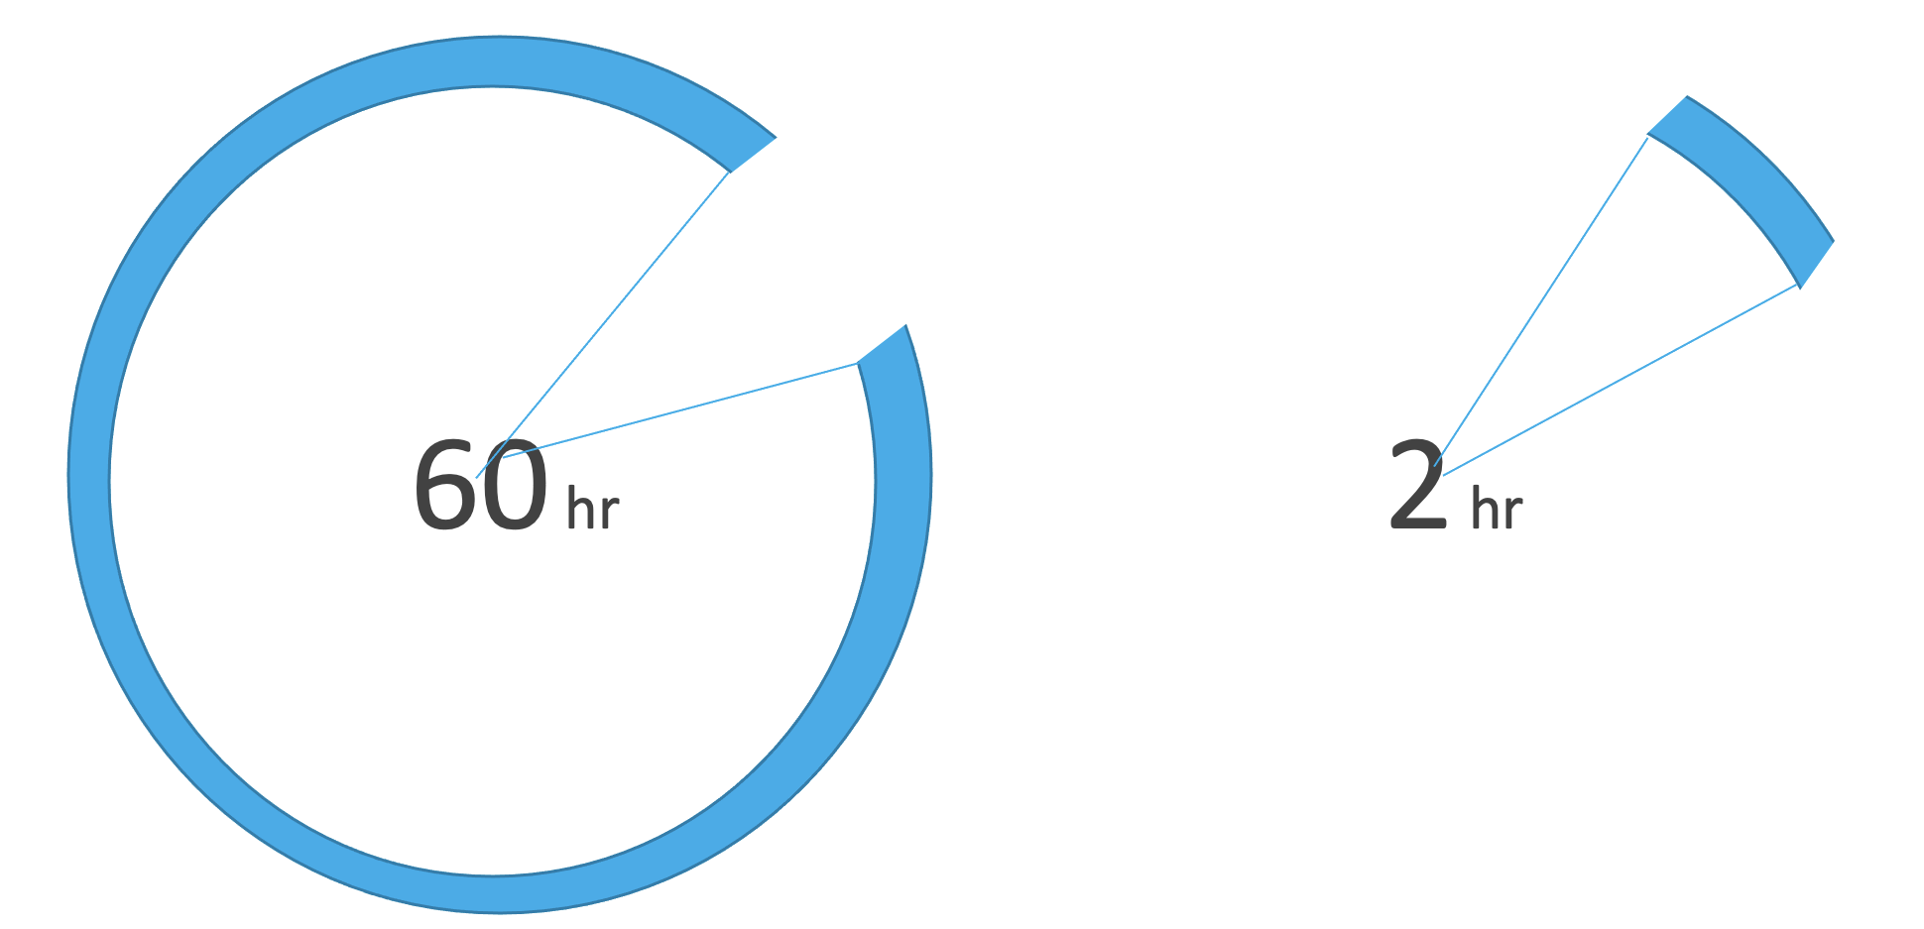
Method:
Data: 2018 R&R study for MRPC+v1 performance testing
Scanner Manufacturer | Model | Field Strength | Site | Acquisition
Siemens | Prisma | 3T | OCMR, Oxford | 2 scans (on-off-on)
Siemens | Avantofit | 1.5 T | OCMR, Oxford | 2 scans (on-off-on)
20 healthy volunteer
10 w/ hepatobiliary condition
10 w/ liver condition
Automatic processing overnight with LMS Dv5 (thanks to João)
66 complete datasets
82.5%
Notes:
loadAndProcessWithAutomation.m run batch analysis overnight

Slide 5
Pineapple Juice Experiment
Performance Testing
Experiment
Scan 1
VS
Scan 2
PJ

Slide 6
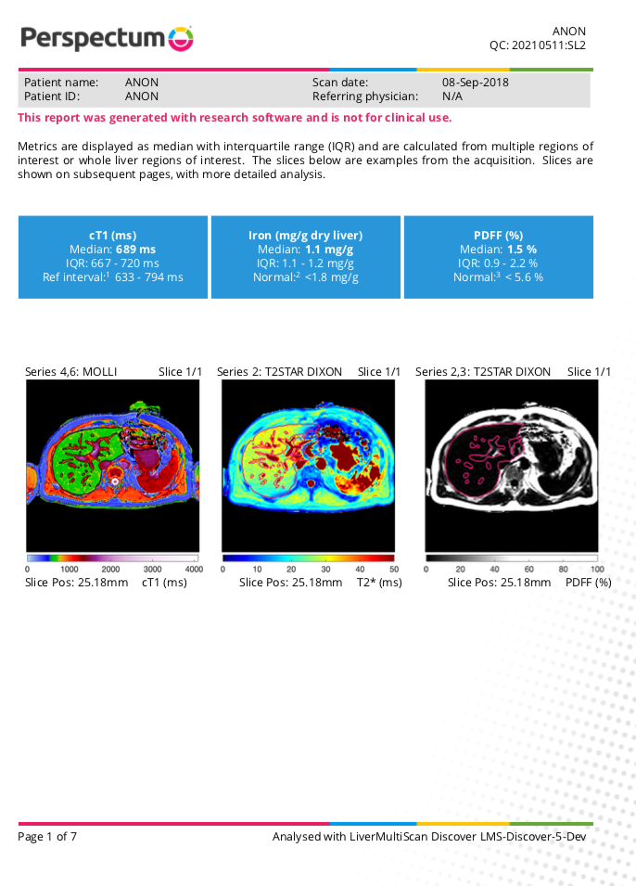
Example Report
Available at the Portal!
Notes:
Example report
Direct Iron
Quantification from segmenatation

Slide 7
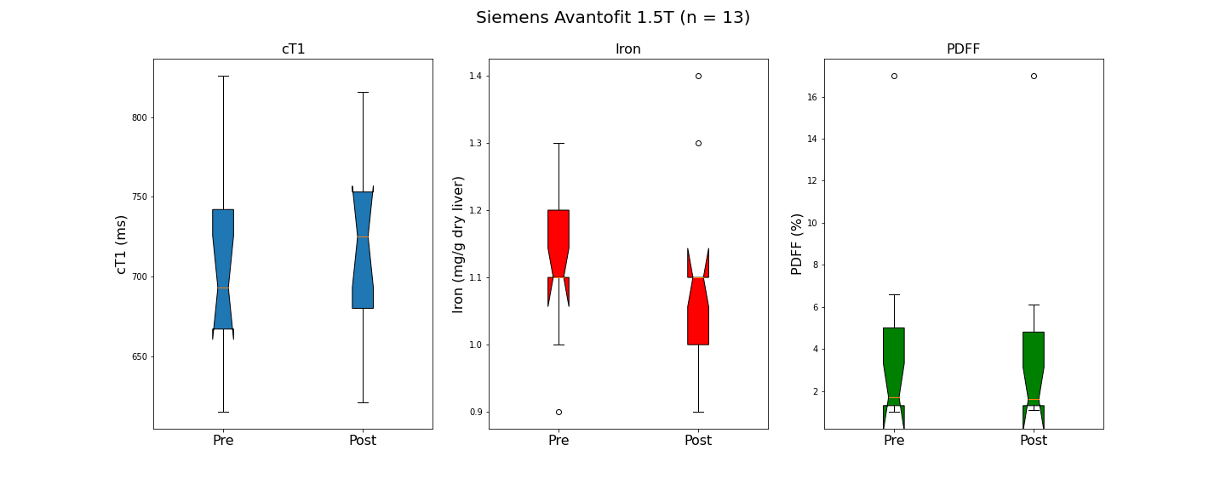
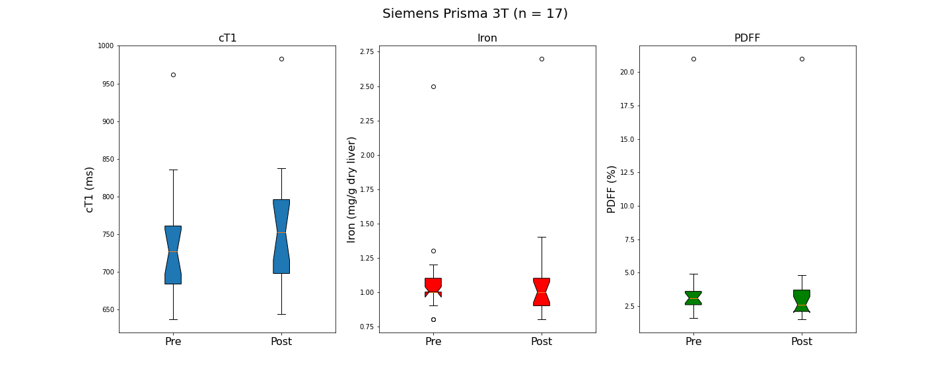
Explore the distribution

Slide 8
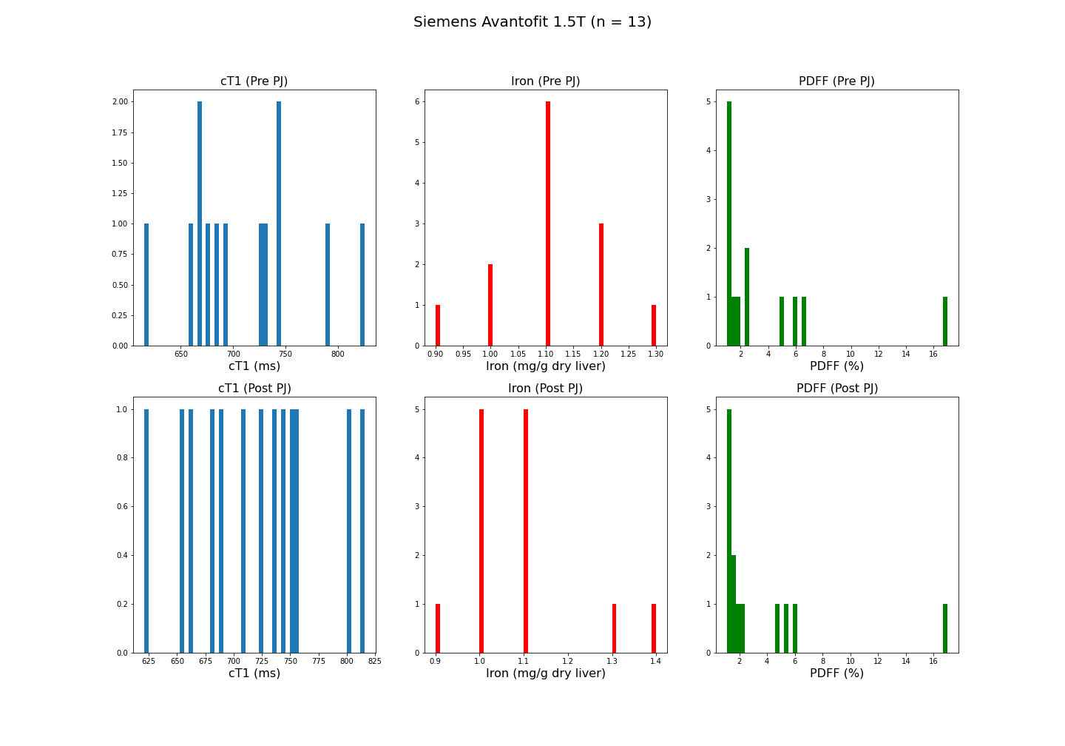
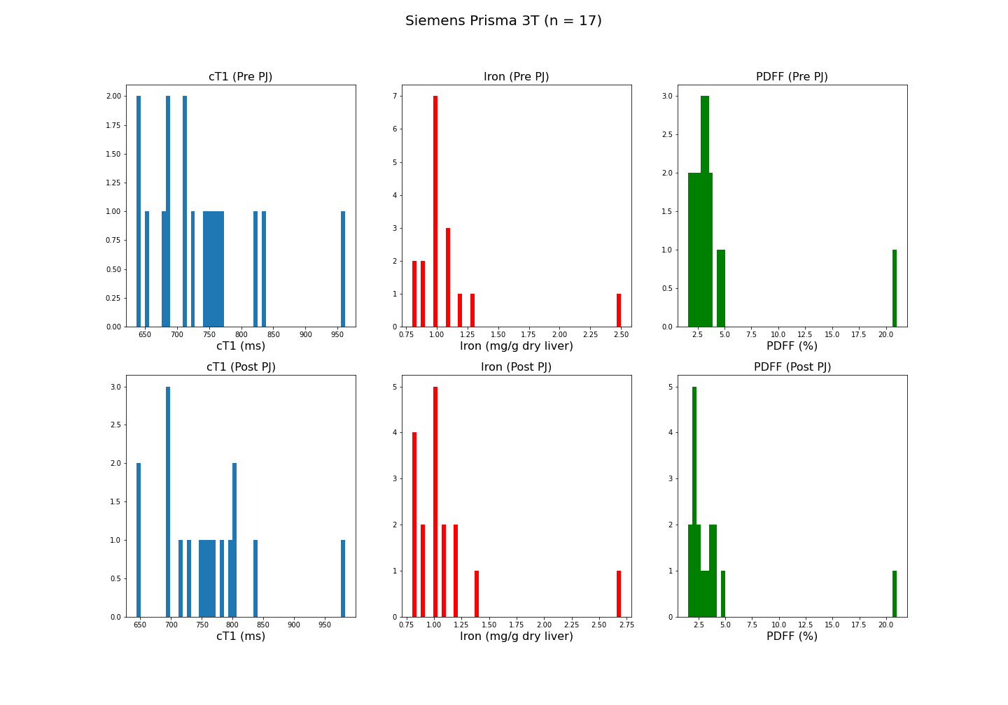
Explore the distribution
Strictly speaking, these data does not follow normal distribution

Slide 9
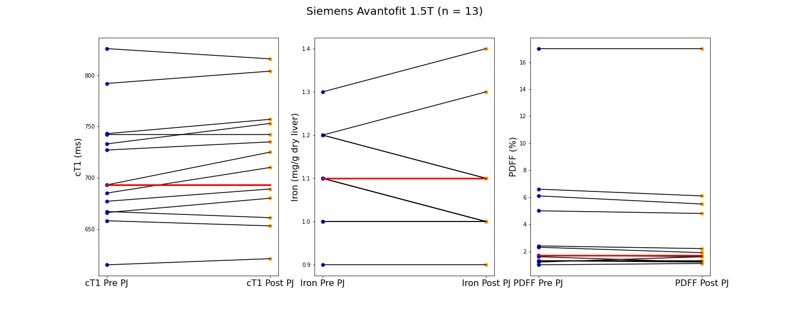
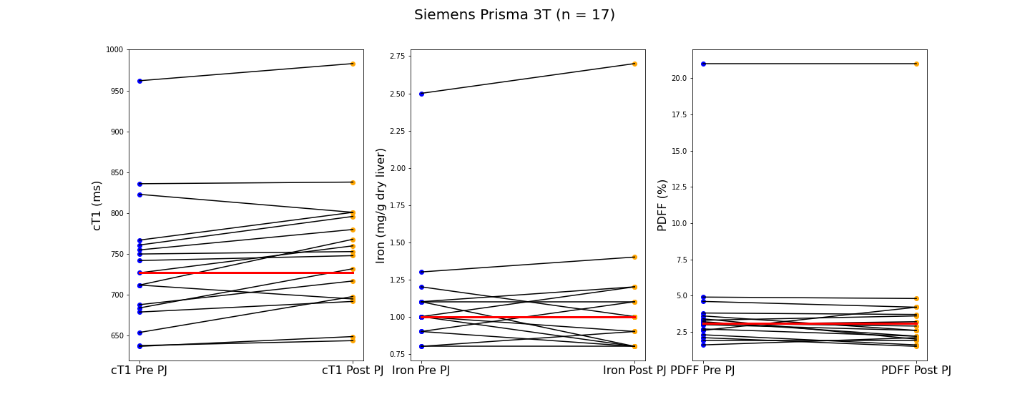
Findings
How big is the differences?
Notes:
plots is meant to show the trend of the biomarkers change after PJ administration.
the blue dots on the left is the pre and orange dots represent the post.
The red line indicates the median for for the individual distribution.
I then use the lines to connect the dots of pre and post results, but it doesn’t seem to have a huge difference.

Slide 10
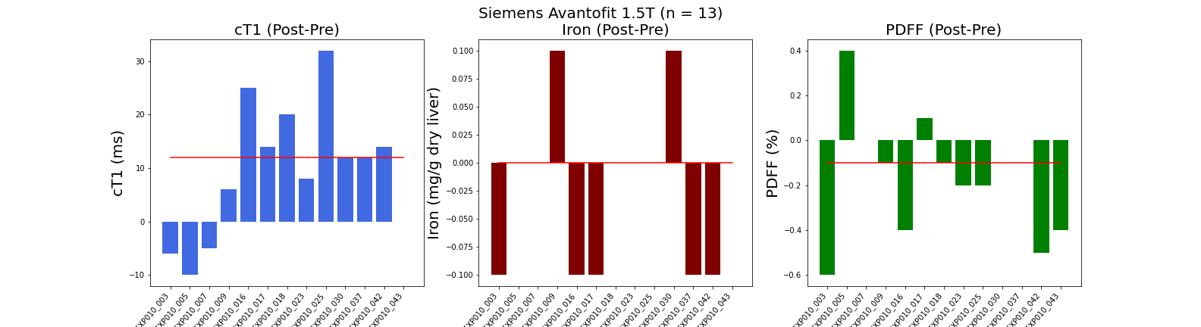
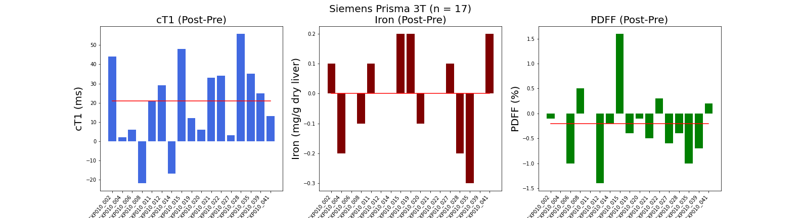
Findings
12.0
0.0
-0.1
21.0
0.0
-0.2
Notes:
At this point, we would have concluded that the pineapple juice does make the difference
That actually is concerning
In order to rule out the difference is because of measurement error
Compare with existing performance testing data for LMSv3

Slide 11
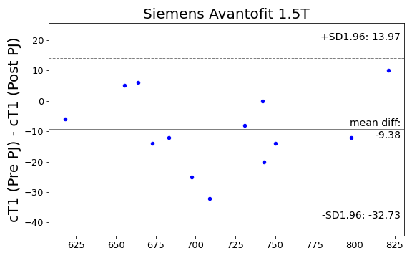
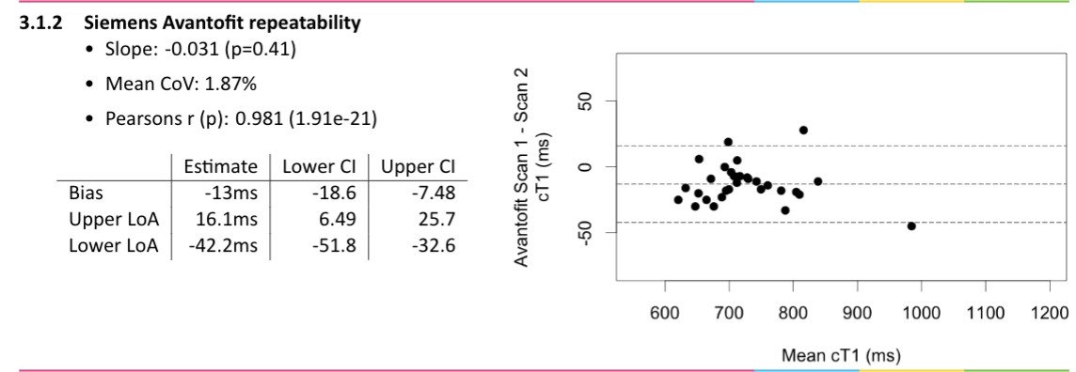
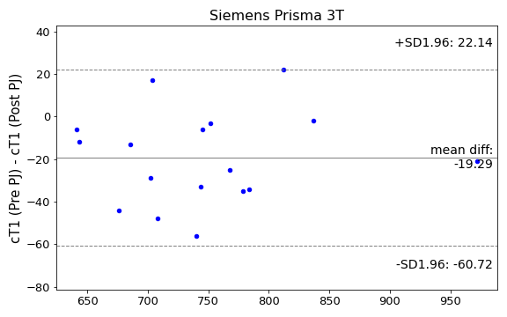
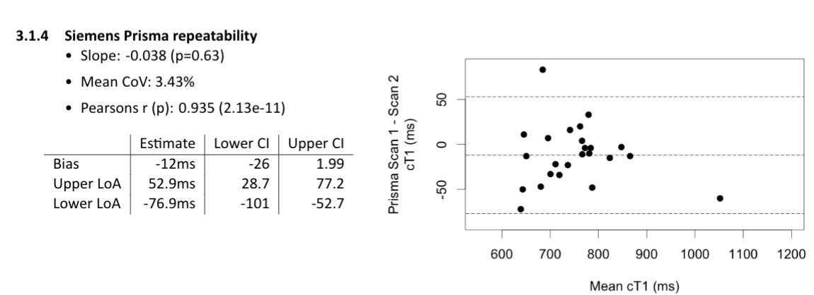
cT1 Segmentation Repeatability

Slide 12
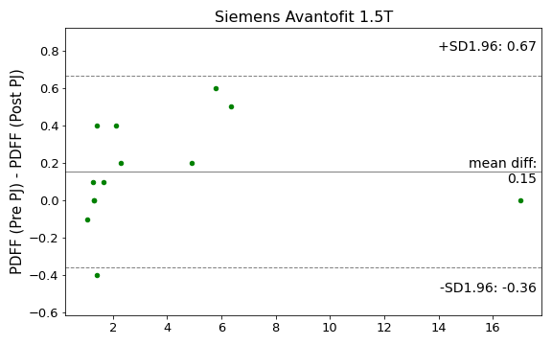
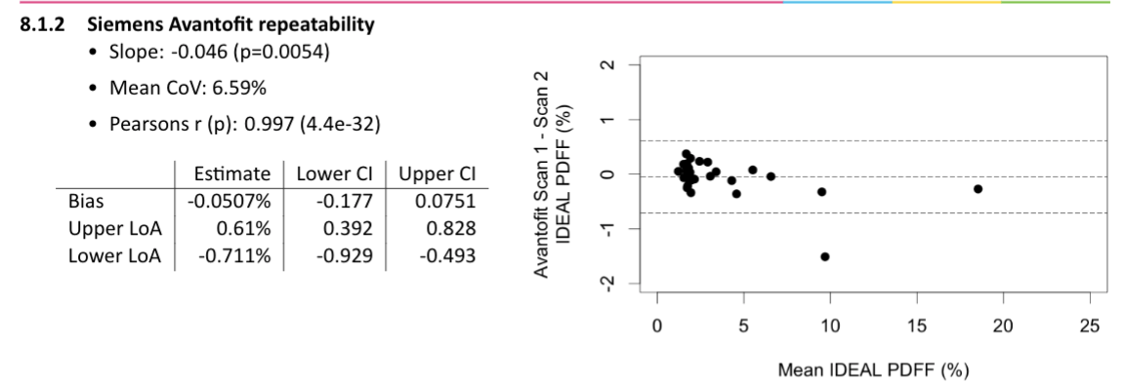
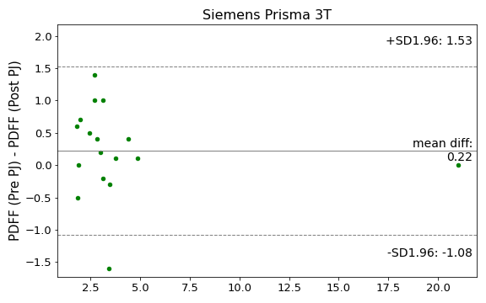
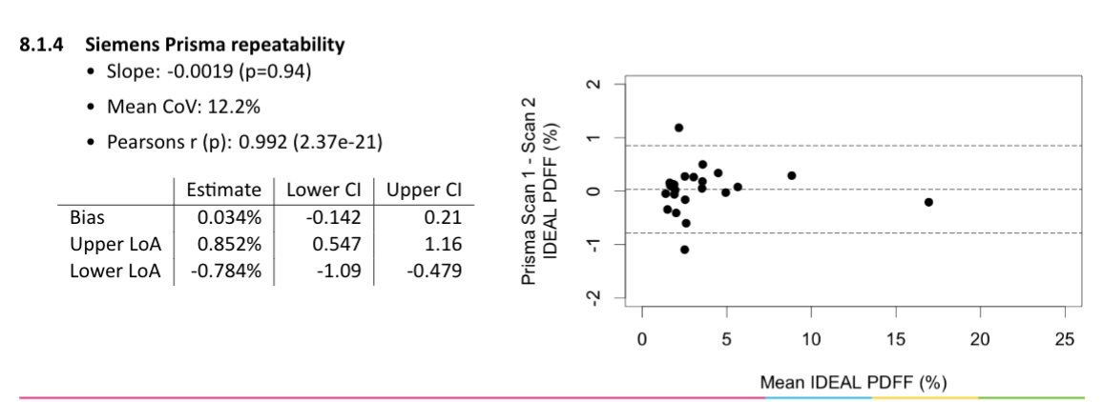
IDEAL PDFF Segmentation Repeatability

Slide 13
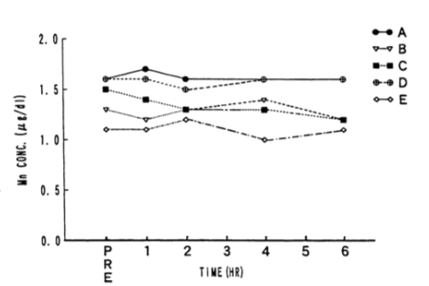
Conclusion
The pineapple juice does not affect cT1 and PDFF
Hiraishi, K et al. have found manganese from orally administered fruit juices are poorly absorbed and do not significantly elevate serum
Total of 18mg manganese ingested,
Blood sample drawn at 1h, 2h, 4h and 6h after PJ
Scalable automatic tool + Thoughtful image acquisition
Notes:
Future work: Iron concentration

Slide 14
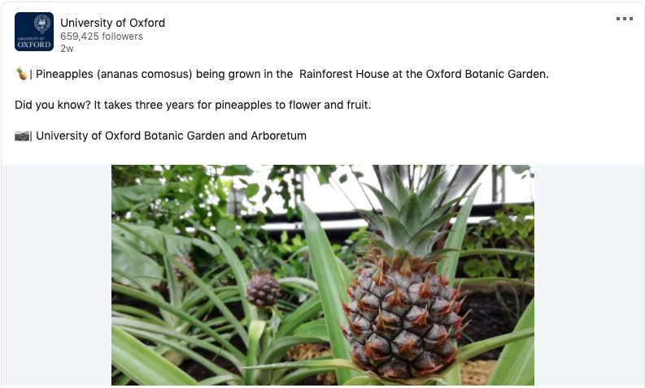
Thank you all (and some fun fact about 🍍)

Slide 15
References
MRCP+v1 Phantom Performance Testing Report -- RA302 RA303
LiverMultiScan v3 In Vivo Performance Testing Report – IIP105
Image-based Automatic Processing Algorithmic specification – RTD0555
Radiopedia: Gasterointestinal MRI Contrast Agents
Mohabir, Sheryl et al. “The efficacy of pineapple juice as a negative oral contrast agent in magnetic resonance cholangiopancreatography.” SA journal of radiology vol. 24,1 1875. 29 Jul. 2020, doi:10.4102/sajr.v24i1.1875
Alshehri, Fahad Mohammed Ali. “Comparative study of pineapple juice as a negative oral contrast agent in magnetic resonance cholangiopancreatography.” Journal of clinical and diagnostic research : JCDR vol. 9,1 (2015): TC13-6. doi:10.7860/JCDR/2015/10240.5463
Hiraishi, K et al. “Blueberry juice: preliminary evaluation as an oral contrast agent in gastrointestinal MR imaging.” Radiology vol. 194,1 (1995): 119-23. doi:10.1148/radiology.194.1.7997537
Office of Dietary Supplements - Manganese. https://ods.od.nih.gov/factsheets/Manganese-HealthProfessional/.

Slide 17
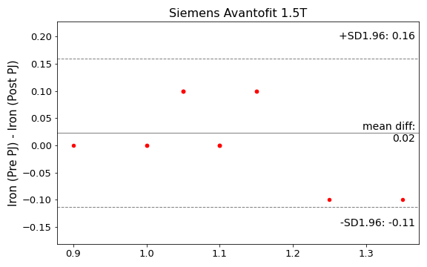
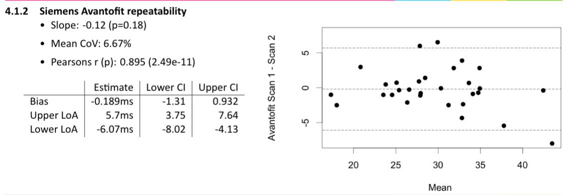
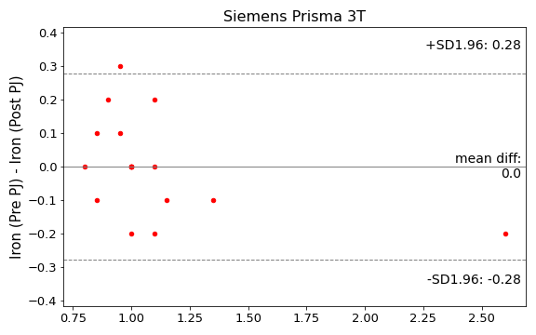
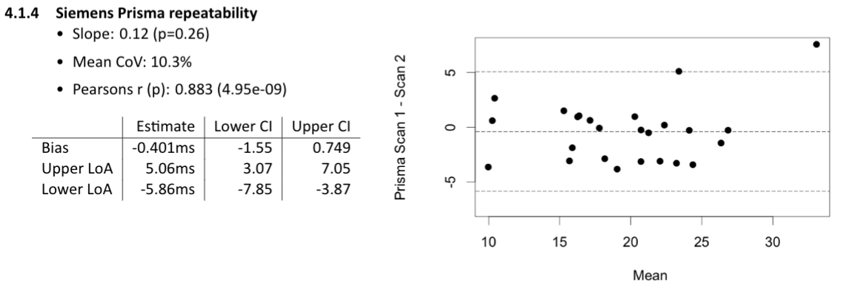
Iron vs T2* DIXON ROI Repeatability
Note that there is addition variable: the PJ data quantify the T2* values of a whole segmented liver but LMS performance testing data quantified T2* values of ROIs

